Slide 1
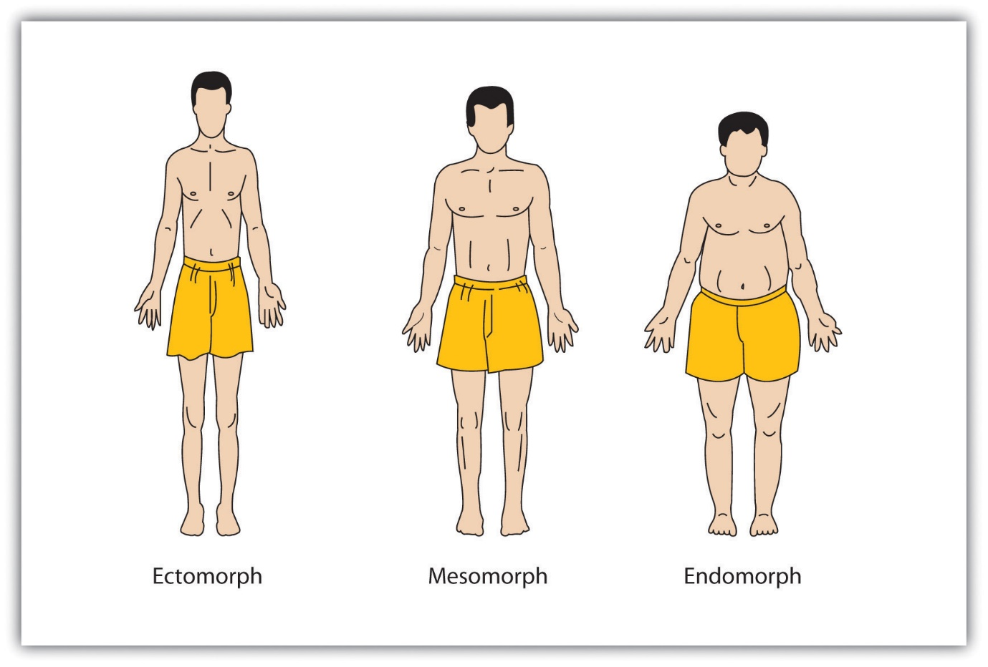
Body fat Prediction using ML
Project By,
M.Senthil Kumar M.Sc.,(MathS)

Slide 2
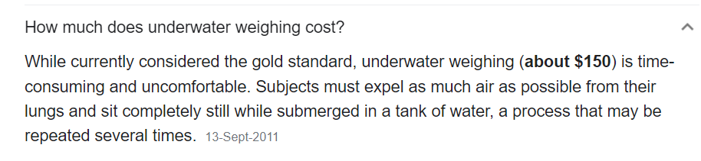
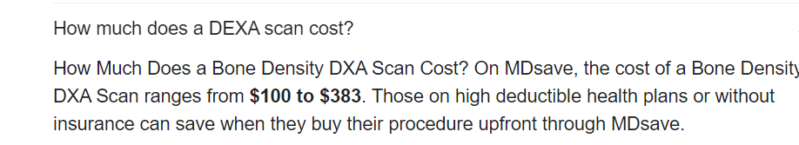
Dataset Overview
Context:
Lists estimates of the percentage of body fat determined by underwater weighing and various body circumference measurements for 252 men.
Educational use of the dataset:
This data set can be used to illustrate multiple regression techniques. Accurate measurement of body fat is inconvenient/costly and it is desirable to have easy methods of estimating body fat that are not inconvenient/costly.
Motive:
We can Find body Fat using DXA scan or Underwater weighing test,
using this we can find density and Apply it Siris equation,
but both of them highly Expensive all are above $150
and it India DXA scan costs in range of 6000rs-15000rs
,to eliminate highly Expensive Method to find body fat
,I tried to build an accurate method at no cost and simple in Home, using Ml Model.

Slide 3
Content:
The variables listed below, from left to right, are:
Density determined from underwater weighing
Percent body fat from Siri's (1956) equation
Age (years)
Weight (lbs)
Height (inches)
Neck circumference (cm)
Chest circumference (cm)
Abdomen 2 circumference (cm)
Hip circumference (cm)
Thigh circumference (cm)
Knee circumference (cm)
Ankle circumference (cm)
Biceps (extended) circumference (cm)
Forearm circumference (cm)
Wrist circumference (cm)

Slide 4
In this project:
Clean and Understand the data
Visualize
Creating EDA for the dataset
Creating prediction model to predict Density
Using Siri formula predict body fat by predicted density
In this dataset, both density and body-fat percentage exist. We will find out soon that density is largely correlated to body fat and inclusion of this feature can greatly improve prediction.
However, calculating density is costly and time-consuming.
Thus, a model that can predict density or a model that can predict body fat without including density might be more helpful.

Slide 5
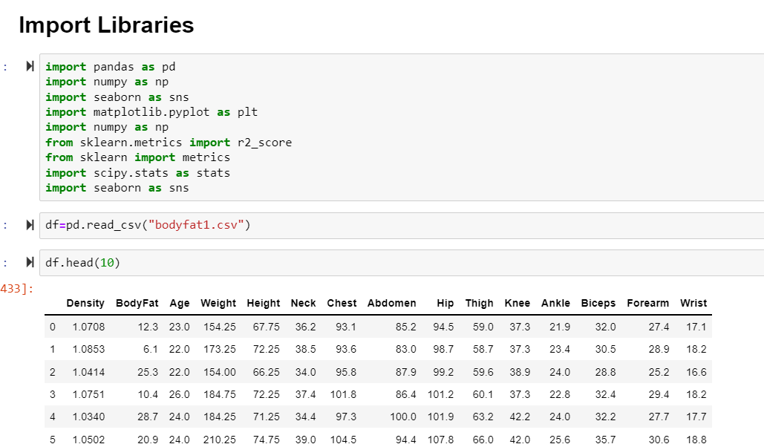
1.Insert an Required libraries and read an Csv file

Slide 6
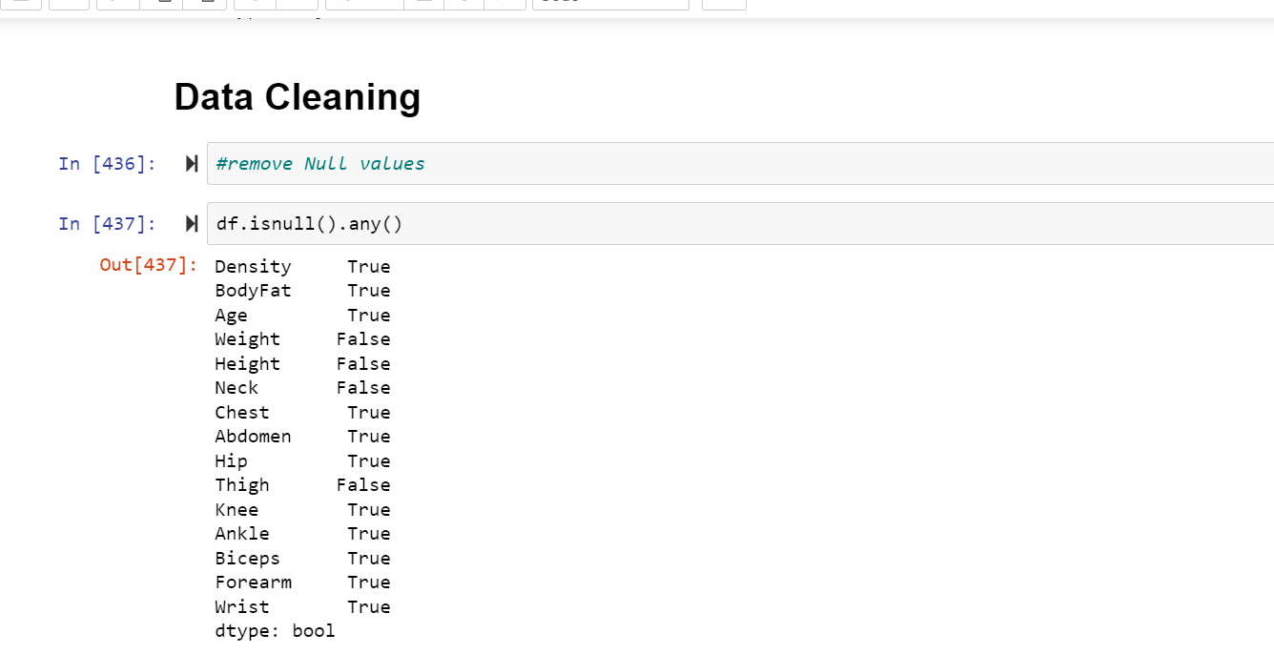
2. We have check null if exists drop an row otherwise replace with mean(because all are continuous)

Slide 7
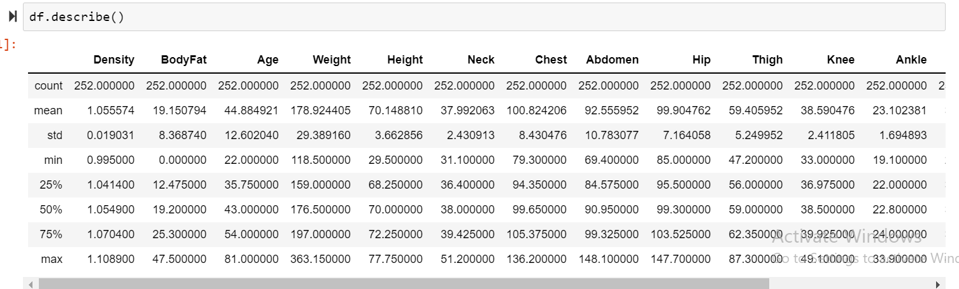
3.After clean data we describe our data statisticaly

Slide 8
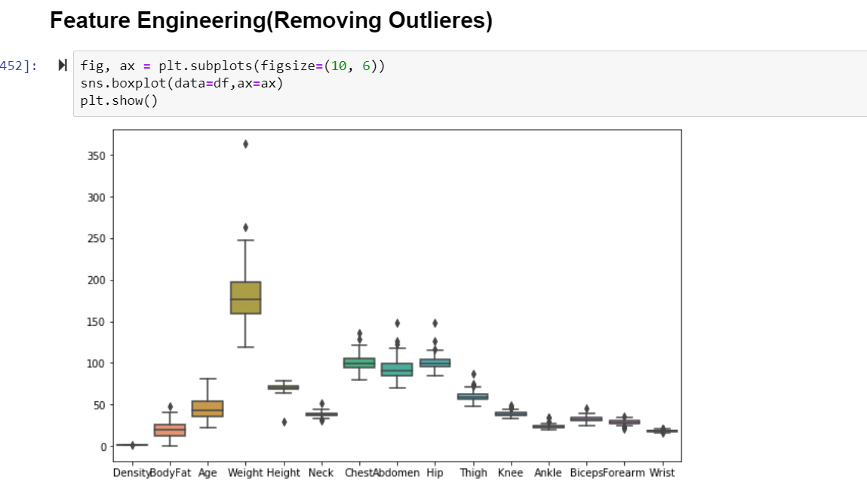
4.We check outlieres using box plot in our data set, if it present we want remove outlieres

Slide 9
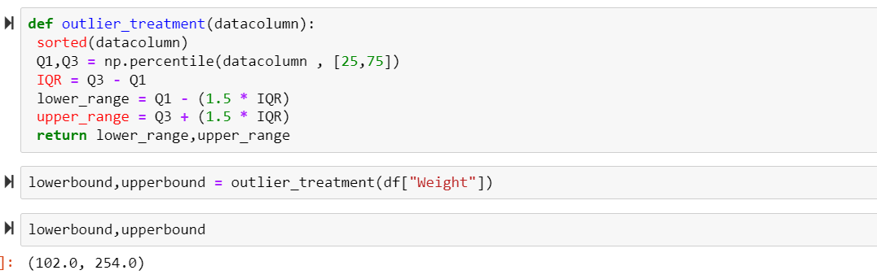
5.We remove outlieres using IQR(Interquartile range) find upper bound and
lower bound of each coloumns which contains outlieres and remove it

Slide 10
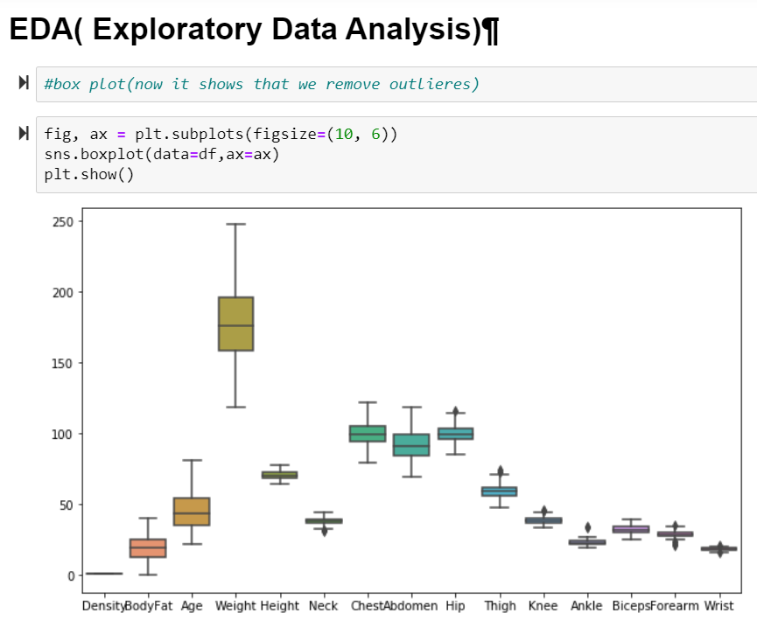
6.After Removing outlieres our boxplot shows how our data are stable

Slide 11
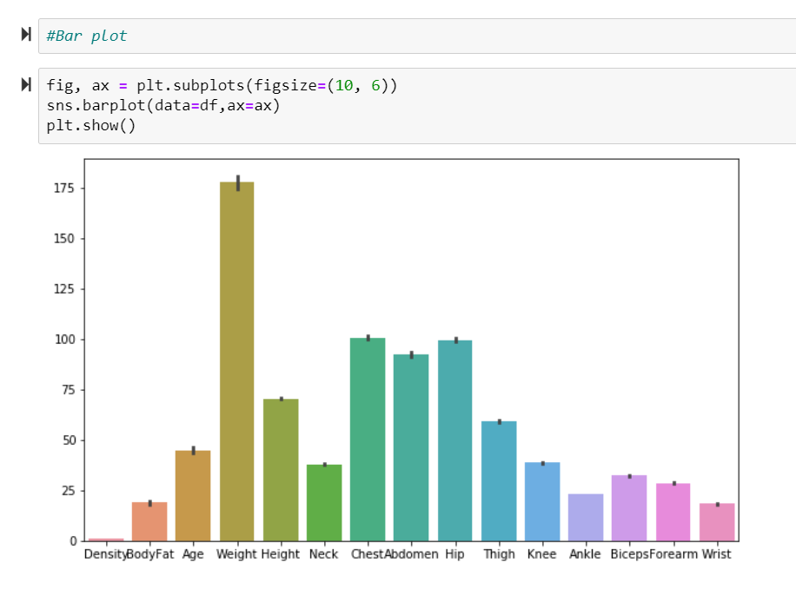
7. Bar plot

Slide 12
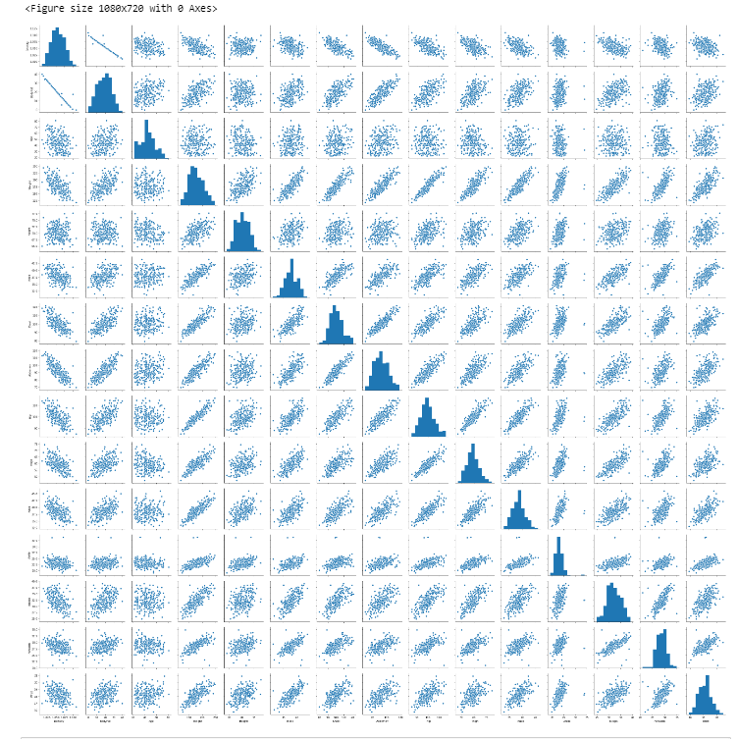
8.Pairplot Shows how Data was scattered and how our data are normally distributed
or it skewed

Slide 13
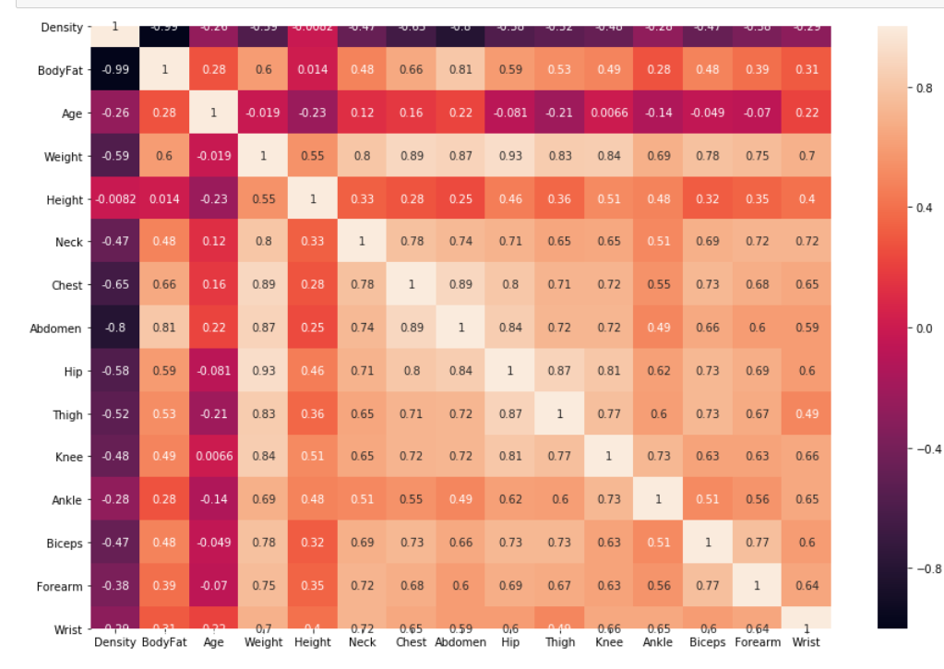
9.Corelation Matrix which shows how data are corelated

Slide 14
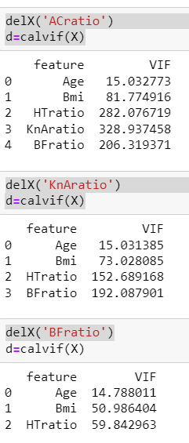
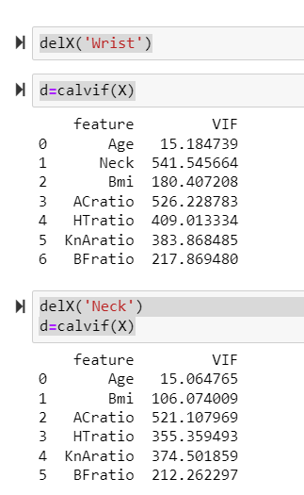
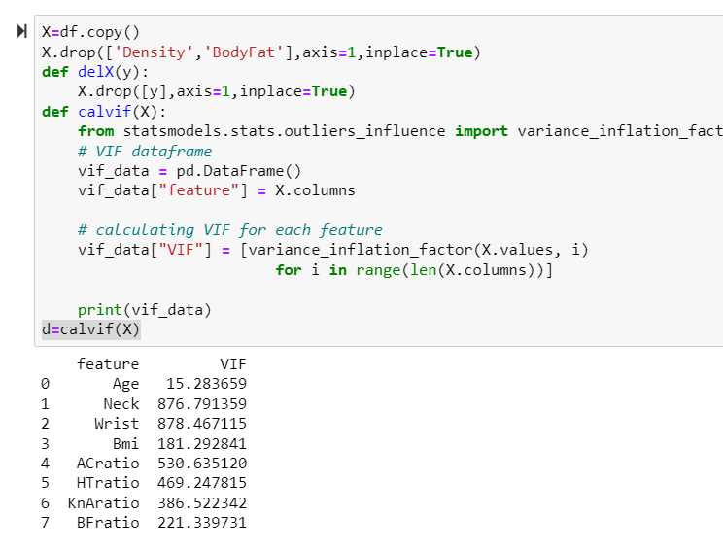
10.Because multicolinearity , we calculate VIF to remove which are highly Corelated coloumns,
ideal VIF value must be less than 5-10.

Slide 15
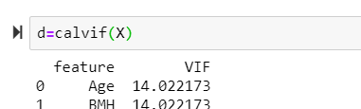
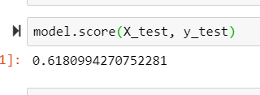
11. We remove All VIF values which are higher, So then ratio BMI of Hratio ,
then check VIF it also greater than 10, if we remove The Any one , then
it’s makes overfit.
Model score of the Two Features is 61% ,but regular we get 68% ,so it shows
VIF is Not Useful , so we remove this VIF process

Slide 16
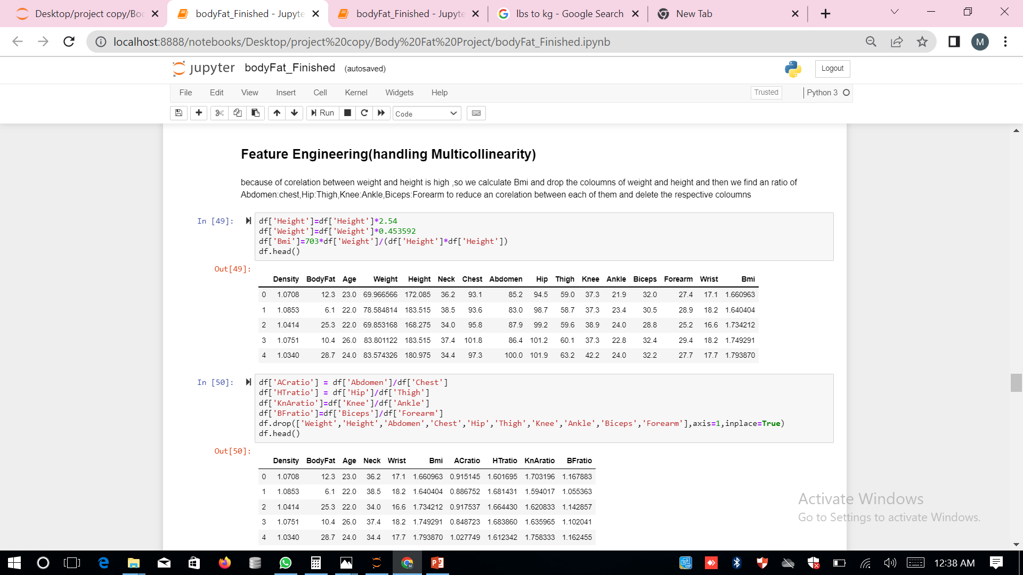
12.All our data was correlated Heavily which most of them greater than .75, so we make an ratio which are correlated and make to reduce correlation between weight and height we calculate BMI,then drop the actual columns which we converted

Slide 17
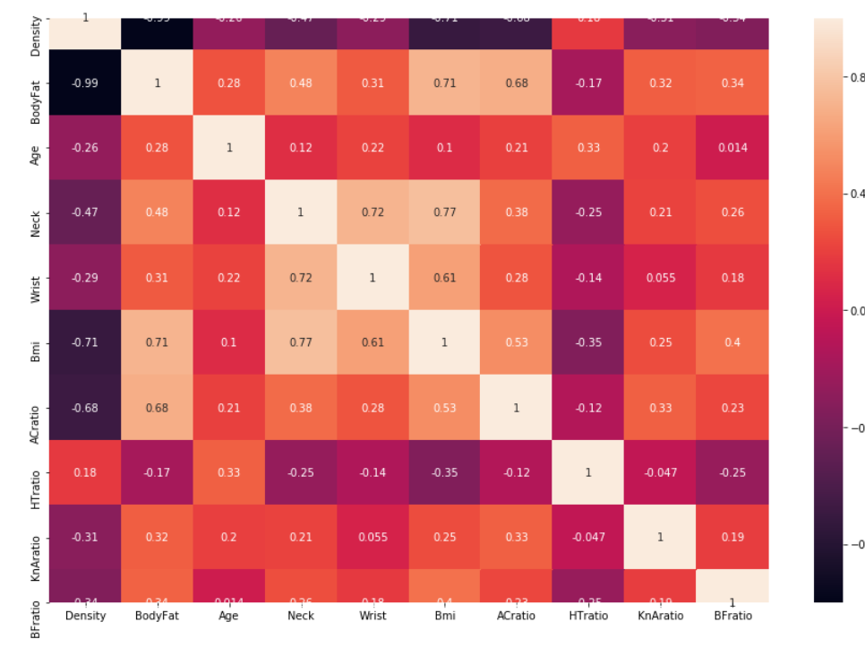
13.After converted, and removed Correlated Features, the Correlation graph is shows how our data was
become less variance than before

Slide 18
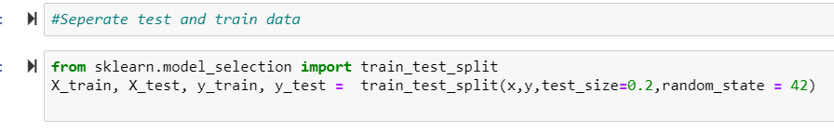
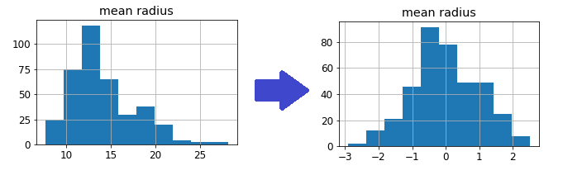
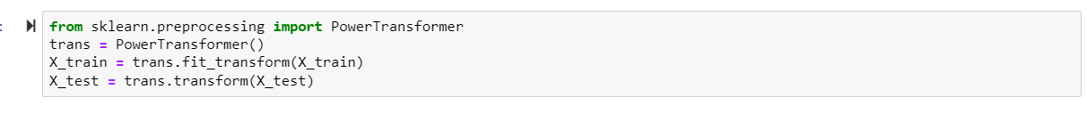
14.We split data as 20% test data and 80% train data
15. from pair plot we note that some of the features are skewed , which is not normally distributed,
so we use a power transform will make the probability distribution of a variable more Gaussian.
This is often described as removing a skew in the distribution, although more generally
is described as stabilizing the variance of the distribution

Slide 19
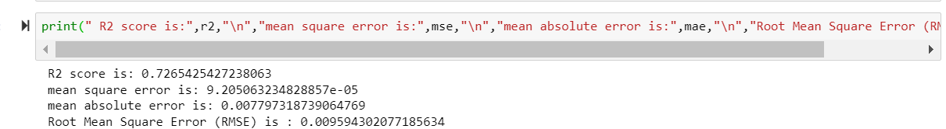
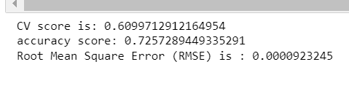
16.After Transformation we built Linear Regression Model, then its accuracy score is 72.65%,
and Rmse(Root Mean Square Eror) is 0.00954
17.And We built Ridge regression , Then its accuracy score is 72.57%, and Rmse is 0.00923

Slide 20
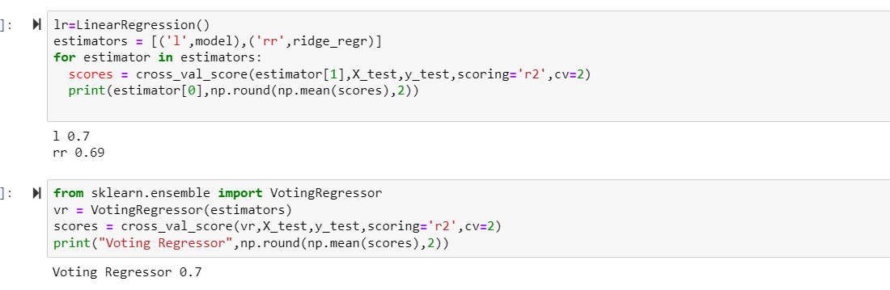
18.Bagging is techniques that can be used to improve the accuracy of Regression model,so we implement Bagging all Regression models are make poor performance which accuracy is less than 60% , the good performer model is Linear & Ridge Regression which accuracy is greater than 72%,so we make bagging
Technique using two models (voting Regression).
In Here voting Regressor is also give same accuracy as an Linear and Ridge models,so I Remove an Bagging Technique from our model

Slide 21
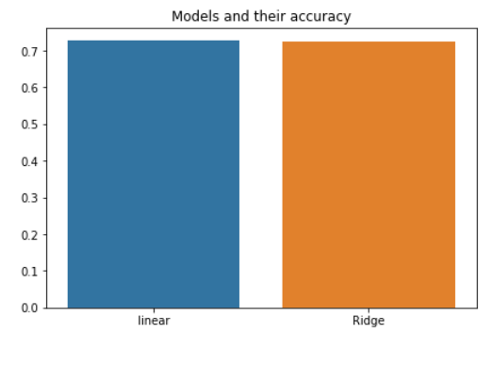
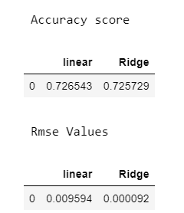
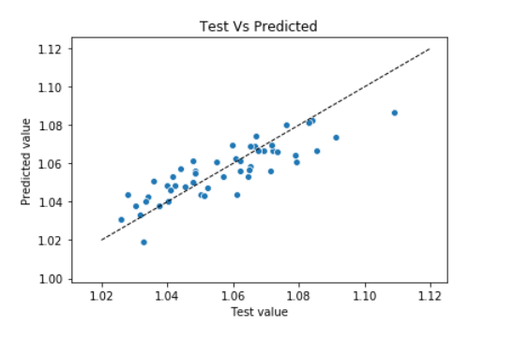
19.Accuracy And Rmse Score is both are approx. equal ,Linear Regression has little More accuracy than
Ridge,so I choose linear Regression as My model
20.So I implement linear regression model, then implement
it , then I plot graph test and predicted value,
to understand how our model is fit.

Slide 22
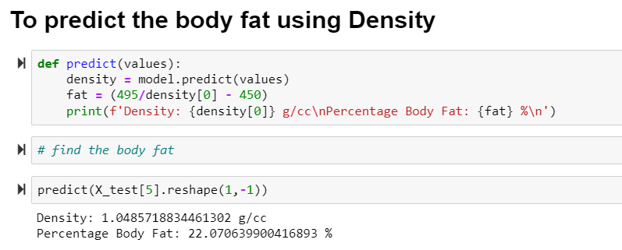
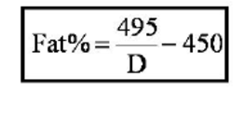
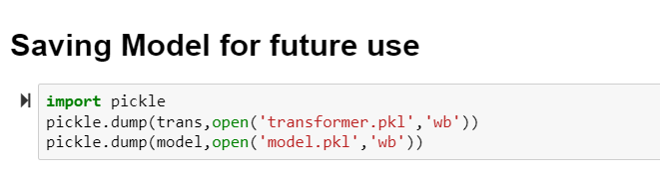
21.After Finding Density Using our model ,then we apply it in Siri’s Equation to find out Percentage of body fat
22.After We built an atmost accurate model, we pickling this model , to use it for further use , which can easily used to another program which reduce Time to build a model

Slide 23
Conclusion:
the prediction tends to be very accurate, Body Fat percentage can be easily calculated using Siri equation, I personally think that further feature engineering to reduce multicolinearity,Hyperparameter optimization and Recursive feature elimination.
Thank You

Slide 24
Thank You

